Slide 1
Fare Amount Prediction Using AI Models
Optimizing Fare Predictions Through Advanced Regression Techniques

Slide 2
Project Objectives
Predict taxi fare amounts using machine learning regression models.
Compare multiple models to identify the best performer.

Slide 3
Data Cleaning & Preprocessing
Missing & Invalid Data Handling
Converted 'pickup_datetime' to datetime format
Removed trips with fare_amount ≤ 0
Removed unrealistic distances (< 0.1 or > 500 miles)
Filtered out invalid bearings (outside -180 to 180)
Datetime Feature Extraction
Extracted hour, day, month, weekday, year from pickup_datetime

Slide 4
Data Cleaning & Preprocessing
Feature Selection
Retained key variables: time features, trip info, landmark distances, external conditions
Preprocessing for Modeling
Scaled numeric features using StandardScaler
Encoded categorical features using OneHotEncoder
Split dataset into 80% training and 20% testing

Slide 5
Key Features Used
Datetime-based features: hour, day, month, weekday, year
Distance and bearing between pickup and dropoff
Categorical: Car Condition, Weather, Traffic Condition (OneHotEncoded)
Landmark distances: JFK, EWR, LGA, NYC center, Statue of Liberty

Slide 6



Models Trained
Linear Regression
Decision Tree Regressor
Random Forest Regressor (with tuning)
Gradient Boosting Regressor
XGBoost Regressor

Slide 7

Evaluation Metrics
MAE (Mean Absolute Error): Average prediction error
RMSE (Root Mean Squared Error): Penalizes larger errors
R² Score: Proportion of fare variability explained by the model

Slide 8
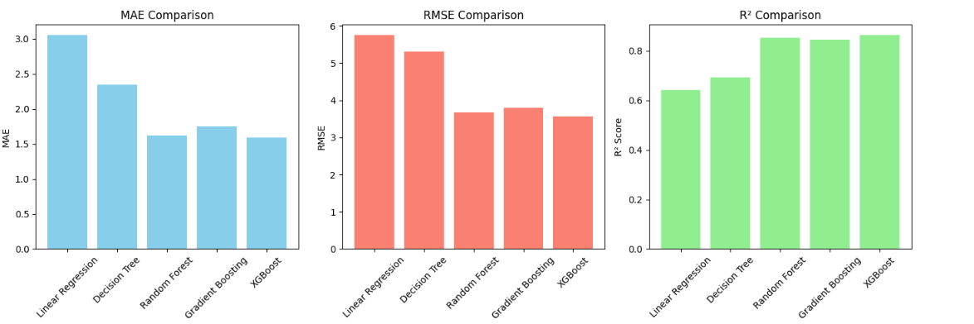
Models Trained

Slide 9
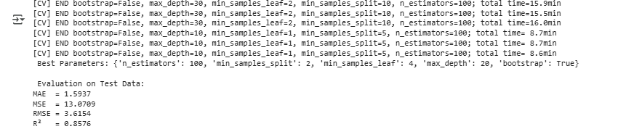
Random Forest Hyperparameter Tuning
Used RandomizedSearchCV with 3-fold cross-validation
Grid included: n_estimators, max_depth, min_samples_split, min_samples_leaf, bootstrap
10 iterations to find best parameters
Best model used for final evaluation

Slide 10
Best Performing Model
XGBoost Regressor:
MAE: 1.5932
RMSE: 3.5620
R²: 0.8618
Random Forest also performed closely after tuning.
Linear Regression had highest error and lowest R².
Gradient Boosting also performed competitively.

